Slide 1
Connecting To MongoDB From Node.js
V. AKSHAYA
22H51A05T5

Slide 2
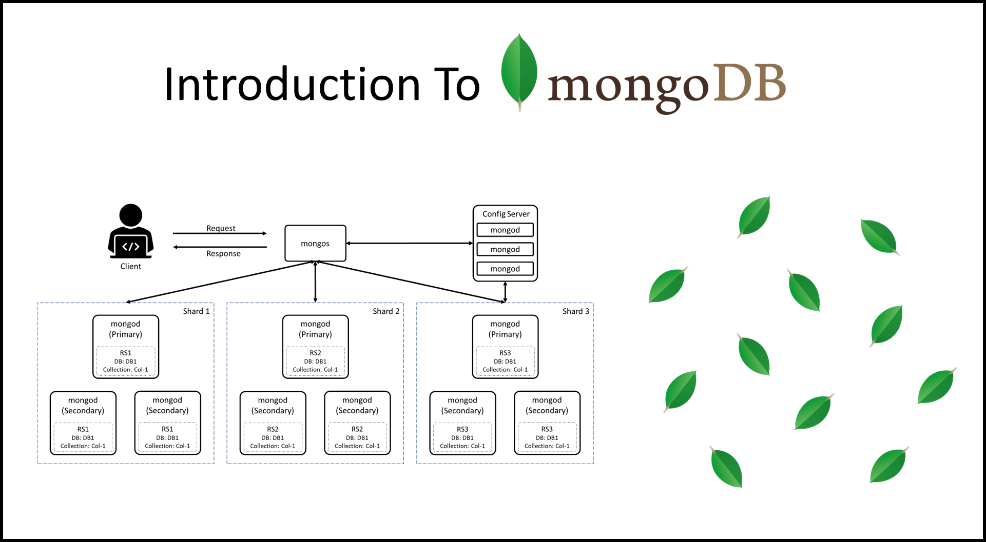
Introduction to MongoDB and Node.js
MongoDB is a NoSQL database that stores data in a flexible, JSON-like format.
Node.js is a JavaScript runtime built on Chrome's V8 engine, enabling server-side scripting.
Connecting MongoDB with Node.js allows developers to build scalable applications efficiently.
The MongoDB Node.js driver makes working with MongoDB from inside a Node.js script simple and intuitive for developers—saving time and increasing productivity.
Notes:
Image source: https://digitalvarys.com/introduction-to-mongodb/

Slide 3

Prerequisites
Ensure you have Node.js installed on your machine before proceeding.
Install MongoDB locally or use a cloud-based service like MongoDB Atlas.
Familiarity with JavaScript and basic database concepts will be beneficial.
MongoDB Node.js driver. To connect your application to a database, you need a software component, also known as a driver. MongoDB Node. ...
MongoDB Atlas. You can create a database either locally or in the cloud by using MongoDB Atlas, a fully managed cloud database service.
Notes:
Image source: https://www.mindluster.com/lesson/67745

Slide 4
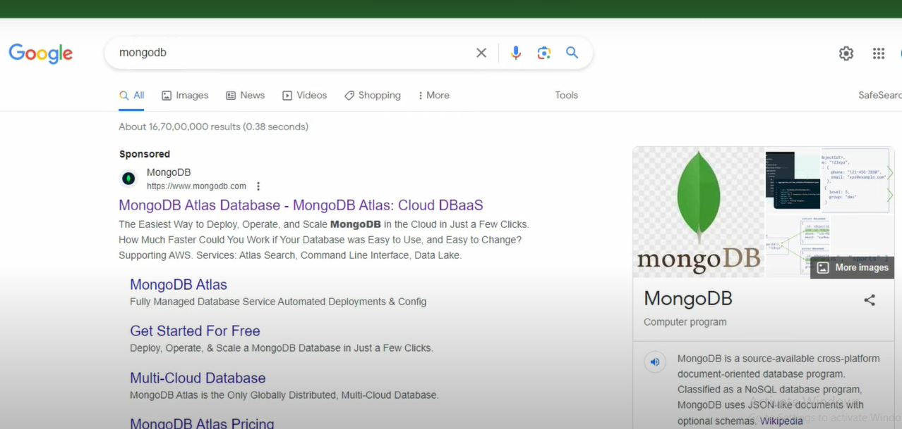
Installing MongoDB Driver
Use npm to install the MongoDB driver by running `npm install mongodb`.
The MongoDB driver enables Node.js applications to communicate with MongoDB databases.
Always check for the latest version of the driver for improved features and security.
Notes:
Image source: https://www.redswitches.com/blog/install-npm-on-windows-and-linux/

Slide 5
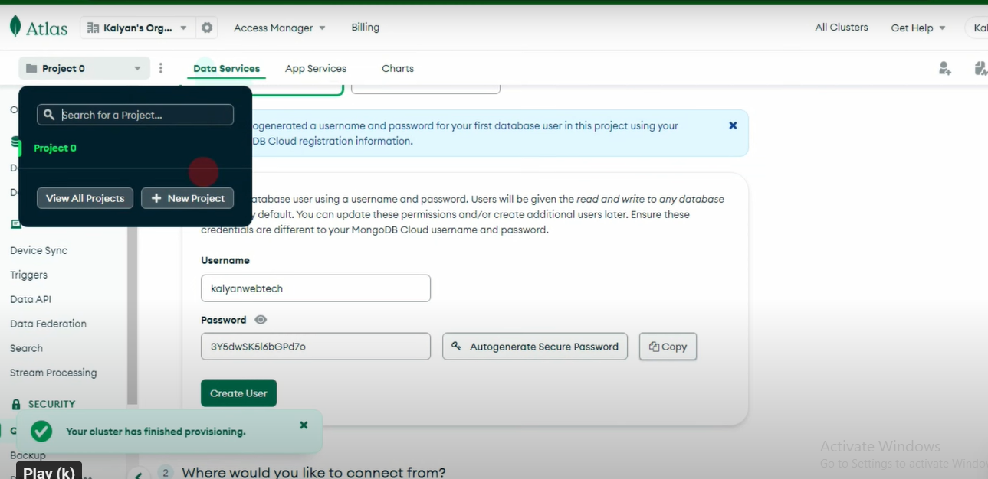
Setting Up the Connection
Use the MongoClient from the MongoDB driver to establish a connection to the database.
Define your connection string, including the database URL and any authentication details.
Install MongoDB Node.js Driver
Set Up MongoDB Connection
Breaking Down the Code
MongoDB URI Format
Running the Node.js Script
Notes:
Image source: https://www.educba.com/mongodb-connection-string/

Slide 6
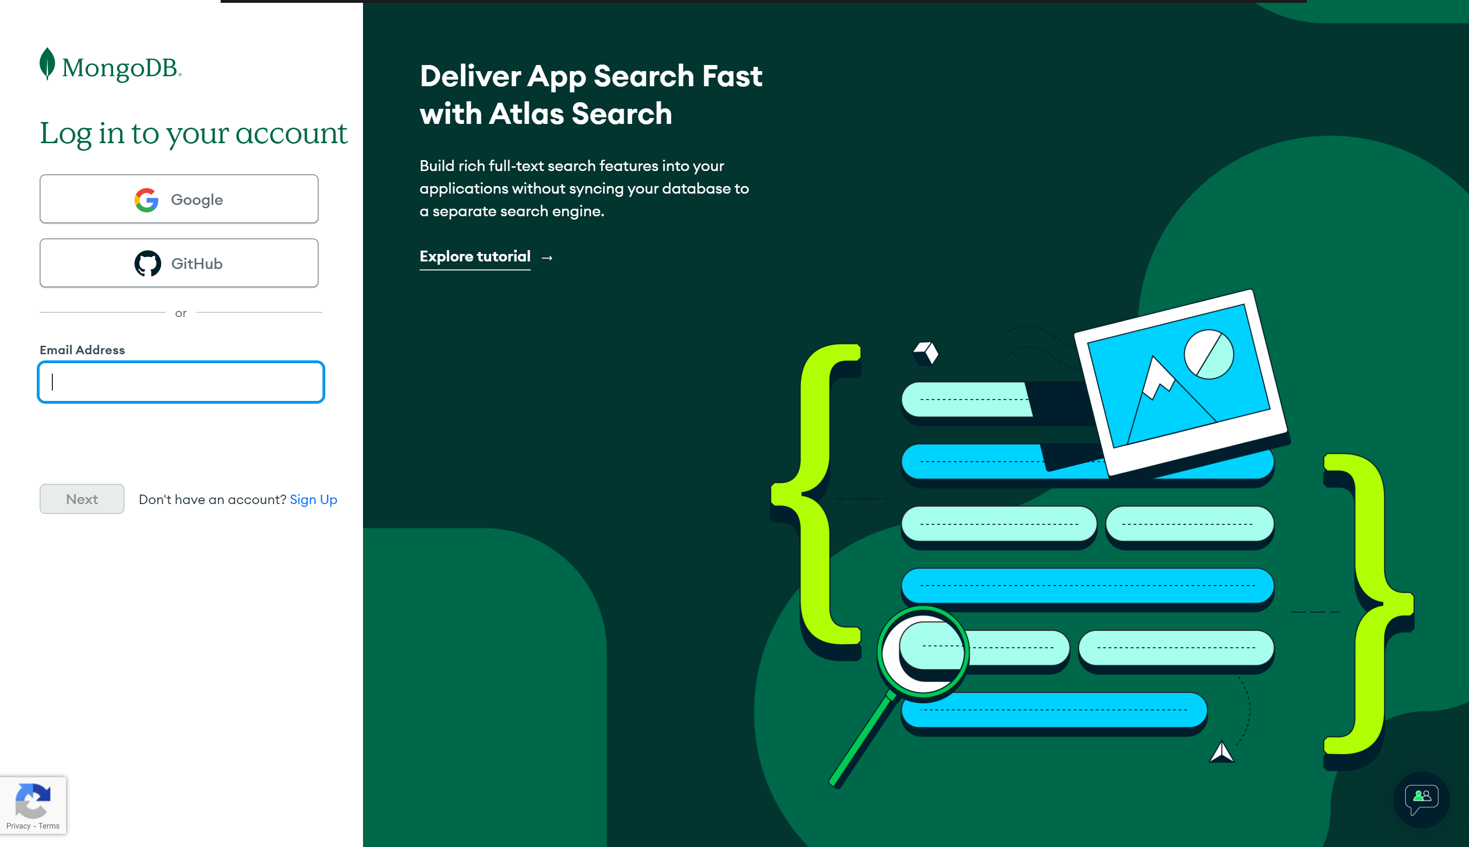
Connecting to MongoDB
Use `MongoClient.connect()` to initiate the connection to your MongoDB instance.
Handle connection errors gracefully to avoid crashing your application.
Once connected, you can interact with your database by accessing collections.
Install the MongoDB Driver
Create a Connection Script
Connecting to MongoDB Atlas
Notes:
Image source: https://learn.mongodb.com/learn/course/connecting-to-a-mongodb-database/lesson-1-using-mongodb-connection-strings/learn?page=2

Slide 7
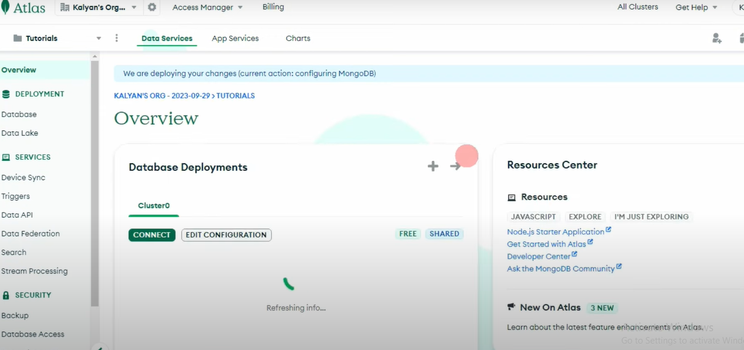
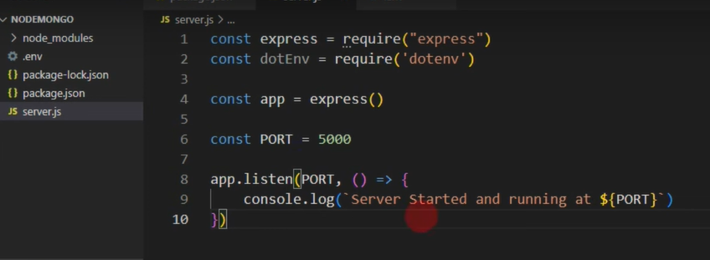

Slide 8
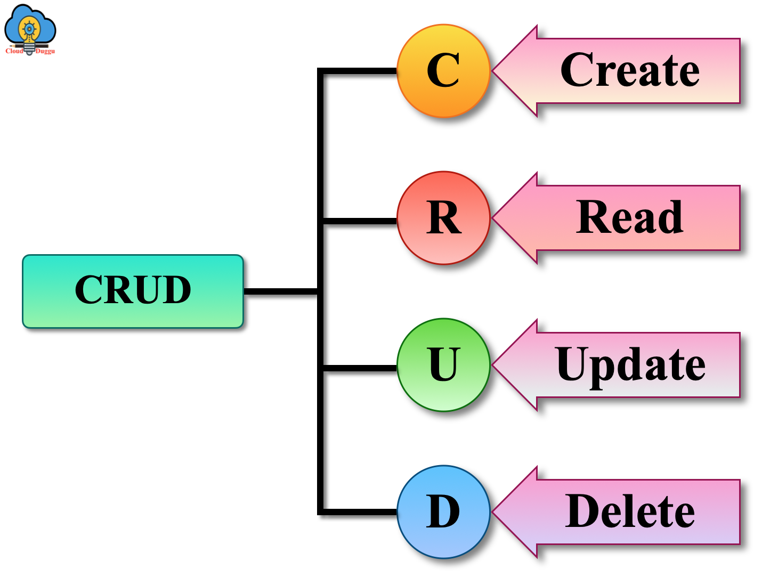
Performing CRUD Operations
CRUD stands for Create, Read, Update, and Delete, which are essential database operations.
Use methods like `insertOne()`, `find()`, `updateOne()`, and `deleteOne()` to manipulate data.
Always ensure to handle the results and possible errors after performing these operations.
Notes:
Image source: https://www.cloudduggu.com/mongodb/crud-operations/

Slide 9
THANK YOU

